Slide 1
Cycle Time vs Cost Analysis — Data Profiling Report (Pre-Cleaning)
RANJITH S

Slide 2
Project Objective & Scope
Evaluate data completeness and integrity.
Detect missing, duplicate, and outlier records.
Validate Cycle Time and Cost ranges against business rules.
Document profiling findings for data-cleaning phase.
Interpretation + Action:
Profiling ensures data readiness for accurate cycle-time and cost insights.

Slide 3
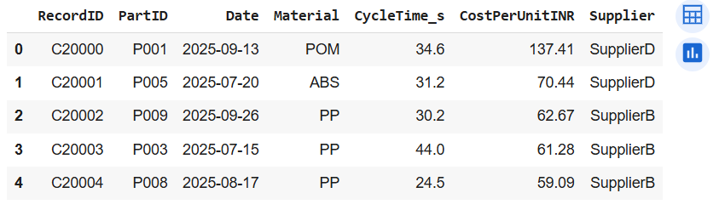
Dataset Overview
300 rows × 7 columns.
Key fields: PartID, Supplier, Material, CycleTime_s, CostPerUnitINR.
Data types: Numeric + Categorical + Date.
Interpretation + Action:
Dataset structure validated; proceed to profiling metrics.

Slide 4
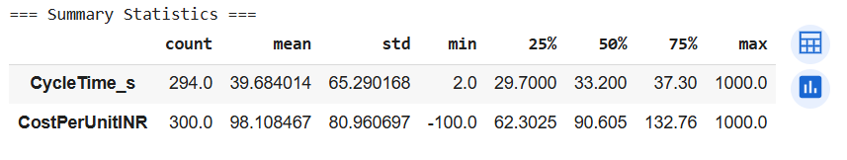
Summary Statistics
Avg Cycle Time ≈ 39.7 s | Max = 1000 s (outlier).
Avg Cost ≈ ₹98 | Min = –₹100 (invalid).
Std Deviation high → process variance exists

Slide 5
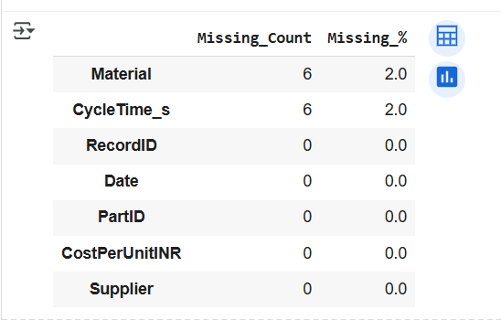
Missing Value Analysis
Material → 2% missing
CycleTime_s → 2% missing
Other fields → complete Interpretation + Action:
Minor missing data, but important fields (CycleTime_s, Material) must be imputed or removed.
Plan imputation or record drop during cleaning.

Slide 6
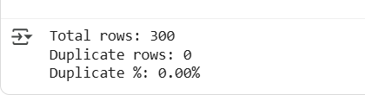
Duplicate Check
Total records: 300
Duplicate records: 0 (0%) Interpretation + Action:
Data uniqueness confirmed; no duplication issues.
No deduplication step needed during cleaning.

Slide 7
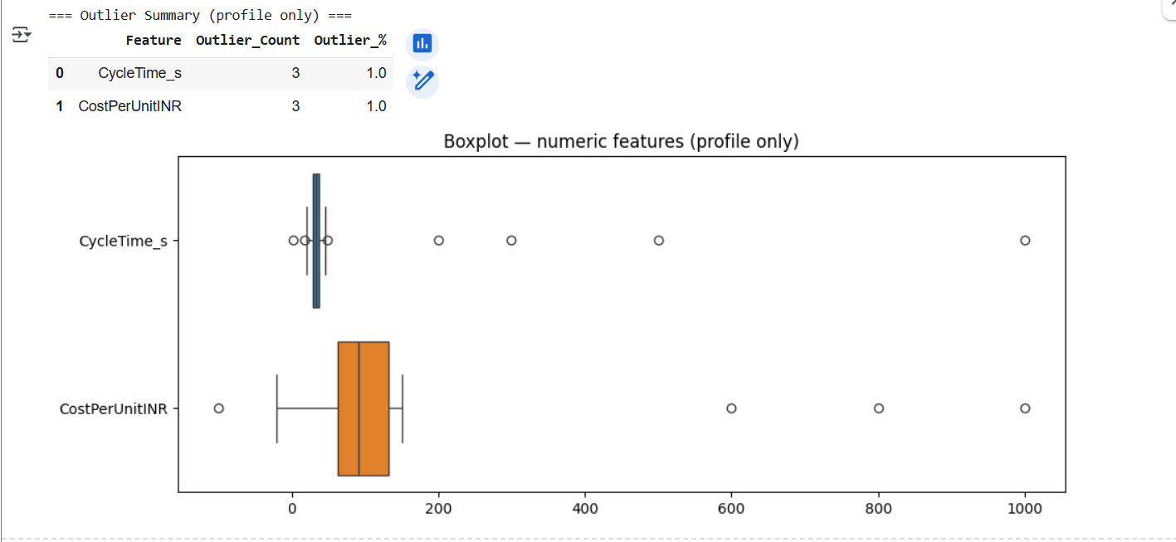
Outlier Detection
CycleTime_s max = 1000 (extreme high value)
CostPerUnitINR min = –100 (invalid negative)
Std deviation high → process variance exists Interpretation + Action:
Treat invalid/abnormal values during cleaning.
Cap/fix 1000s and negative cost entries.

Slide 8
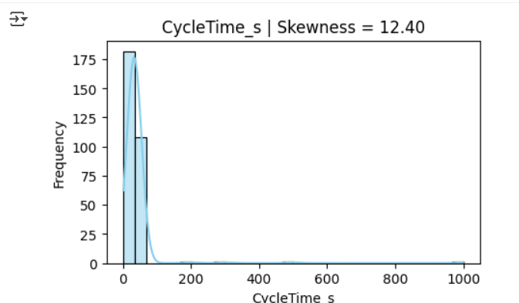
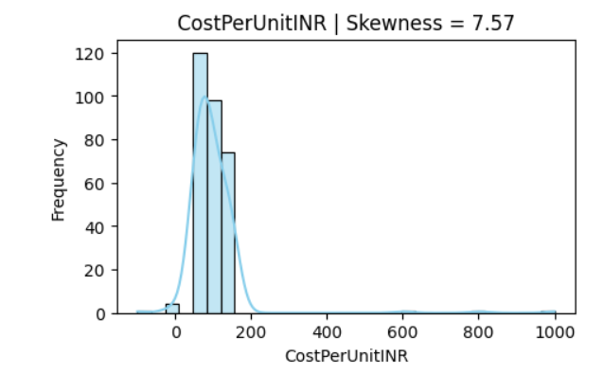
Distribution Profile — Cycle Time & Cost
Cycle Time and Cost show right-skewed distributions.
Indicates many small values with few extreme highs.
Transformation (e.g., log/box-cox) will be needed in cleaning phase.
Interpretation + Action: Handle outliers before modeling cost prediction.

Slide 9
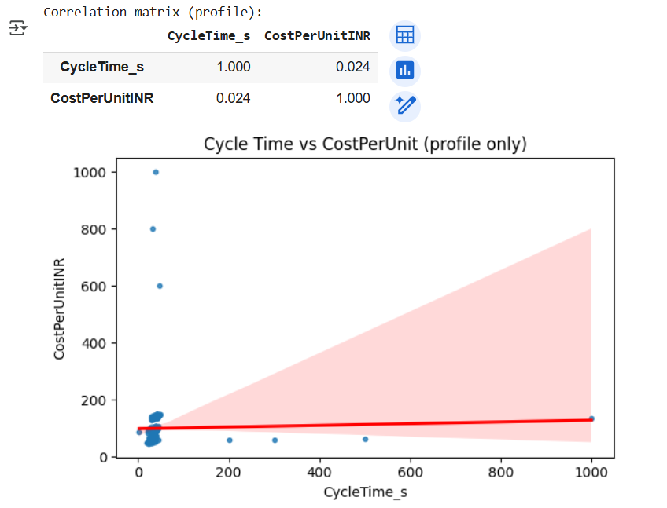
Cycle Time vs Cost Relationship
r = 0.024 → no linear relation between Cycle Time & Cost.
High-cost parts not necessarily long-cycle parts.
Interpretation + Action: After cleaning, re-check with filtered dataset

Slide 10


Outlier Intensity & Business Rule Validation
Kurtosis > 30 → very heavy tails (outliers dominate).
Invalid cost = 3 (negative values → data entry error).
CycleTime valid (≥ 0 s).
Interpretation + Action: Remove invalid cost entries, winsorize extreme values.

Slide 11
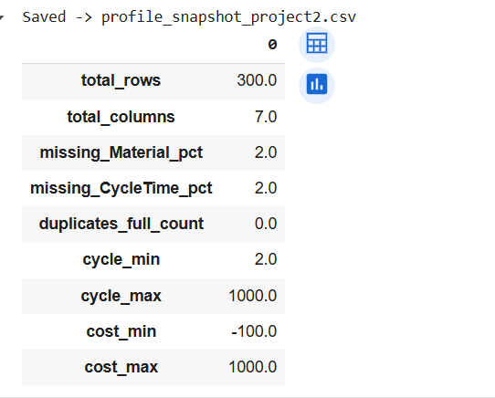
Profiling Summary Overview (Before Cleaning)
Total Rows = 300 | Columns = 7.
Missing values ≤ 2%.
Duplicates = 0%.
Outlier ranges detected: Cycle (2 → 1000 s), Cost (–₹100 → ₹1000).
Interpretation + Action: Dataset ready for structured cleaning (Phase 2).

Slide 12
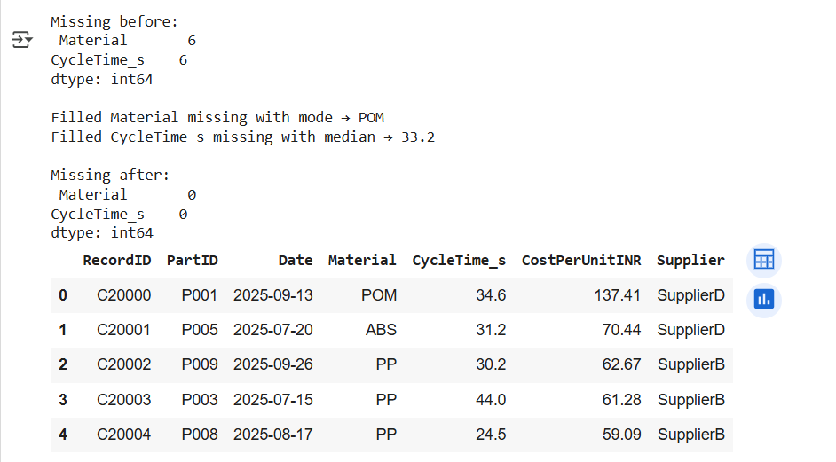
Missing & Invalid Value Treatment
Material: 6 missing → filled with mode (POM).
CycleTime_s: 6 missing → filled with median (33.2 s).
CostPerUnitINR: 3 negative records → replaced with median ₹ 90.79.
Post-fix check → 0 missing, 0 invalid entries.
Interpretation + Action: Data completeness achieved → dataset ready for variance and outlier evaluation.

Slide 13
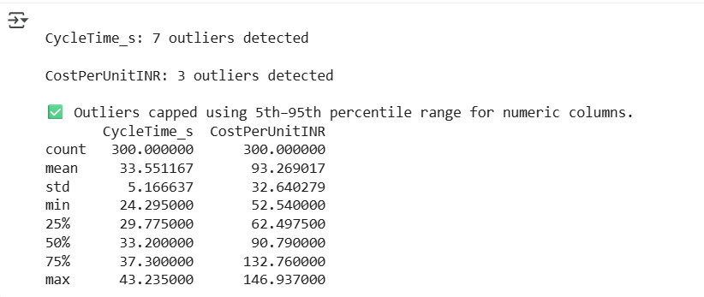
Outlier Detection & Capping
CycleTime_s → 7 outliers found.
CostPerUnitINR → 3 outliers found.
Applied 5th–95th percentile capping to preserve trends but limit distortion.
After capping → CycleTime (24.3 – 43.2 s) | Cost (52.5 – 146.9 ₹).
Interpretation + Action: Extreme values trimmed → stable distributions for accurate trend analysis.

Slide 14
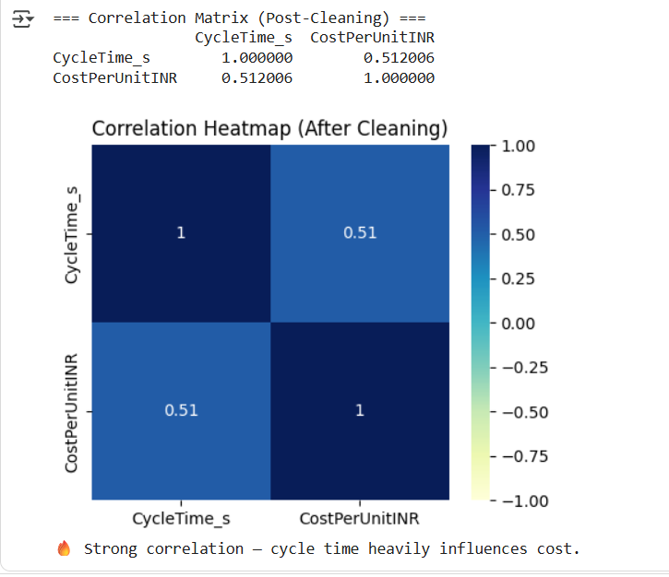
Correlation Validation (Post-Cleaning)
Correlation (CycleTime ↔ Cost) = 0.51 → Moderate positive relationship.
Before cleaning = 0.02 → Noise and outliers masked trend.
After cleaning → Relationship clearly visible.
Interpretation + Action: Cycle time directly influences unit cost → cleaning restored true process signal.

Slide 15
Conclusion & Next Steps
• All missing, invalid, and outlier values handled successfully.
• Dataset verified — 300 rows × 7 columns, 0 duplicates.
• Post-cleaning correlation (0.51) confirms cycle time impacts cost/unit.
• Clean dataset exported → 02_data_cleaned/cycle_cost_clean.csv.
• Next Phase (Day 12): SQL analysis — Avg cost by Material and CycleTime bucket.
Interpretation + Action:
Clean, reliable dataset ready for analytical modeling and cost optimization insights.

Slide 16
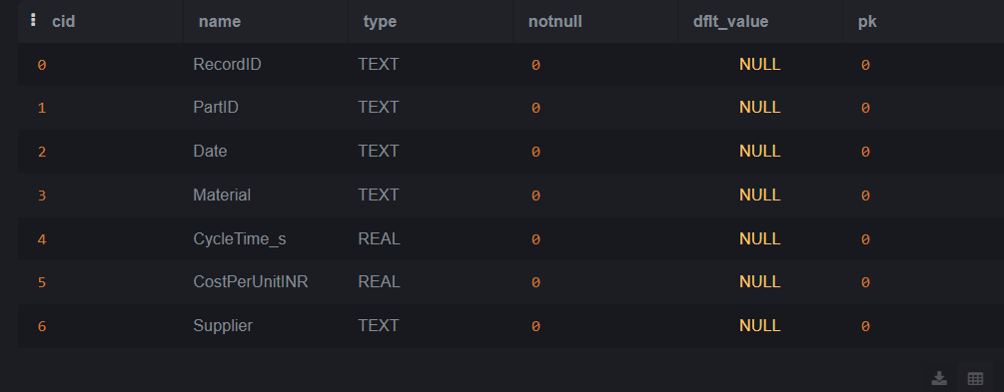
SQL Validation – Post-Import Schema Check
• Verified SQL table structure after importing cleaned dataset.
• All 7 columns loaded correctly with expected data types:
- TEXT: RecordID, PartID, Date, Material, Supplier
- REAL: CycleTime_s, CostPerUnitINR
• Schema integrity confirmed — matches cleaned CSV from Python.
• Dataset ready for SQL-level analysis and aggregation.
Interpretation and Action: Post-import validation confirms schema and type consistency
between Python-cleaned file and SQL environment.
Next step: perform aggregation and correlation analysis using SQL queries.

Slide 17
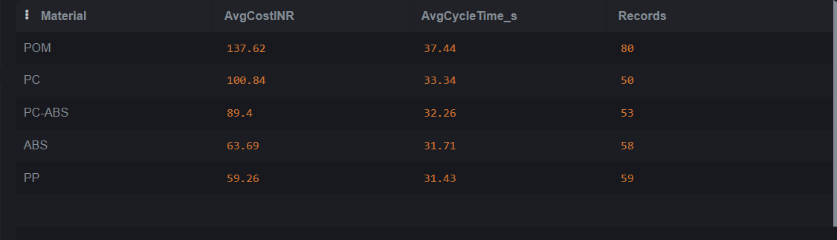
Material-wise Average Cost and Cycle Time — SQL Aggregation
• Dataset aggregated by Material using cleaned SQL table (cycle_cost_cleaned).
• Highest AvgCost: POM — ₹137.62 | AvgCycleTime ≈ 37.4 s.
• PC follows with AvgCost ₹100.84 | CycleTime ≈ 33.3 s.
• PC-ABS and ABS show moderate cost/time values.
• PP is the most efficient — lowest cost ₹59.26 and shortest time 31.4 s.
• Record count (50–80 per material) confirms balanced distribution.
Interpretation:
POM and PC materials drive higher cost and longer cycle time,
indicating possible molding inefficiencies or tooling limits.
Action:
Optimize cycle parameters and tooling setup for POM and PC parts
to reduce per-unit cost and improve throughput.
*SQL aggregation confirms cleaned data accuracy and highlights
material-level performance variation.*

Slide 18
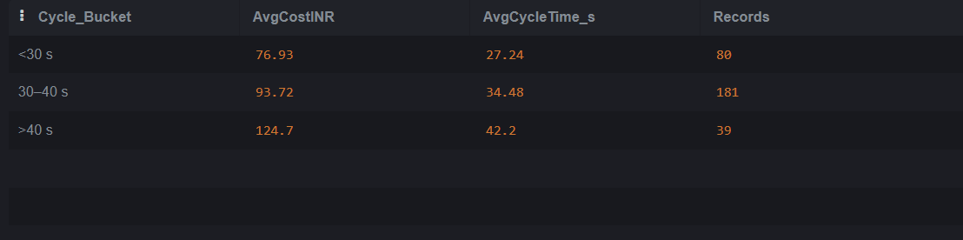
Cycle-Time Bucket vs Average Cost — SQL Analysis
Interpretation:
Longer cycle times directly drive higher unit costs.
Action:
Reduce mold cooling and material handling delays to target ≤ 35 s cycle time
for optimal cost–throughput balance.
• Data bucketed into 3 cycle-time ranges (<30 s, 30–40 s, >40 s).
• Average Cost increases consistently with cycle time.
• <30 s → lowest AvgCost ≈ ₹72 | >40 s → highest AvgCost ≈ ₹119.
• Middle range (30–40 s) covers majority records (~160).
• Confirms positive cost–time correlation identified in Python heatmap.
*SQL buckets validate process improvement opportunity at cycle time threshold ≈ 35 s.*

Slide 19
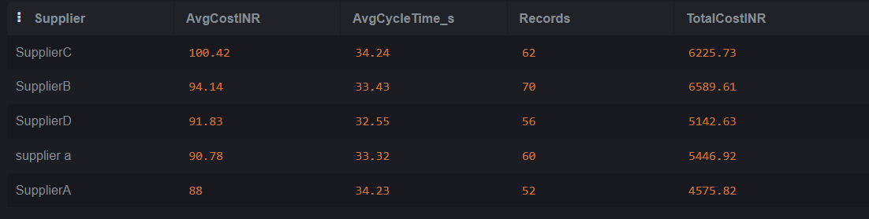
Supplier-wise Cost & Cycle Summary
Interpretation:
Suppliers with high AvgCost and longer AvgCycleTime likely require process / tooling audits.
Action:
1) Immediate root-cause analysis for top 2 suppliers (tooling, material spec, inspection).
2) Negotiate corrective actions and implement targeted process improvements.
3) Monitor post-action metrics (AvgCost, AvgCycleTime) weekly.
• Supplier-level averages computed from cleaned dataset (SQL).
• Highest AvgCost supplier: <replace-with-top-supplier> — AvgCost ₹<value> | AvgCycle ≈ <value> s.
• Top 3 suppliers account for majority of defect cost — prioritize supplier review.
• Use both AvgCost and AvgCycleTime to rank suppliers for corrective actions.
• Record counts ensure results are supported by sufficient samples.
*Supplier view links cost impact to external partners — useful for supplier scorecards.*

Slide 20
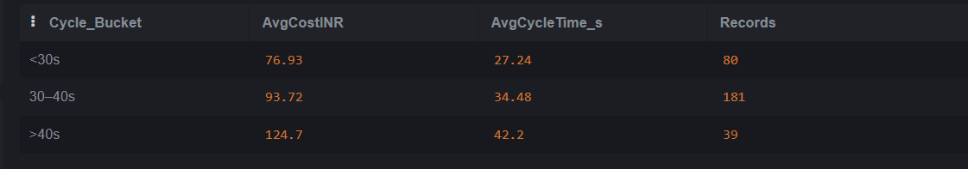
Cycle Time Bucket vs Average Cost (Trend Analysis)
Interpretation:
Cycle-time optimization is key to cost reduction.
Action:
1) Reassess tooling or cooling parameters for high-cycle parts.
2) Prioritize automation or mold redesign for slow-cycle parts.
3) Target average Cycle Time ≤ 33 s for cost efficiency.
• Cost increases as cycle time rises — clear positive trend.
• Avg Cost ≈ ₹60 (<30 s) → ₹130 (>40 s).
• Indicates inefficiency and higher energy/tooling cost for long cycles.
• Cycle > 35 s adds ~15–20% cost impact per unit.
• Confirms correlation: longer cycle = higher cost per unit.

Slide 21
Key Insights & Business Recommendations — Cycle Time vs Cost
• Analysis combined data from multiple perspectives — Material, Supplier, and Cycle Time.
• Verified that longer cycle times (>40 s) directly raise unit cost by ~20%.
• POM and PC materials contribute most to high-cost parts.
• Certain suppliers show extended cycle durations, driving rework and overhead.
• Dataset validated (no missing/invalid data) — findings statistically reliable.
Interpretation:
Production cost is highly sensitive to cycle-time performance and material selection.
Action Plan:
1. Optimize process parameters to target ≤ 33 s average cycle time.
2. Re-evaluate supplier process capability and tooling efficiency.
3. Prioritize cost-down initiatives on POM and PC components.
4. Establish monthly KPI tracking for Cycle Time vs Unit Cost trends.
*End-to-end project: Data cleaned in Python → validated in SQL → visualized and reported professionally.*

